Slide 1
Unemployment, Job Openings, and Layoffs in the US
Analyzing the US Job Market

Slide 2
Summary
Introduction
Unemployment Rate in 2001 and 2018
The Highest and the Lowest States in Unemployment Rate
Unemployment Change VS Job Openings Change From 2001 to 2018
Unemployment Change VS Layoffs Change From 2001 to 2018
Conclusion

Slide 3
Introduction
Recently, several business newspapers and websites mentioned that the US economy is witnessing a strong growth and the unemployment rate is dropping near all-time low. On the other hand, the Trump administration is tightening on immigrant workers. In this project I wanted to explore and summarize the major changes in the US job market.

Slide 4
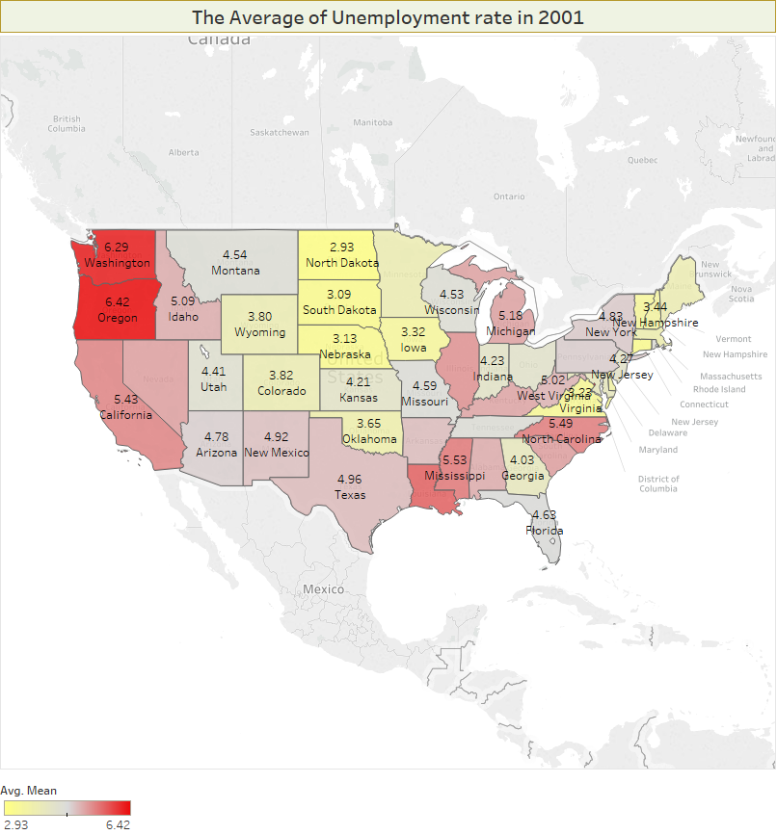
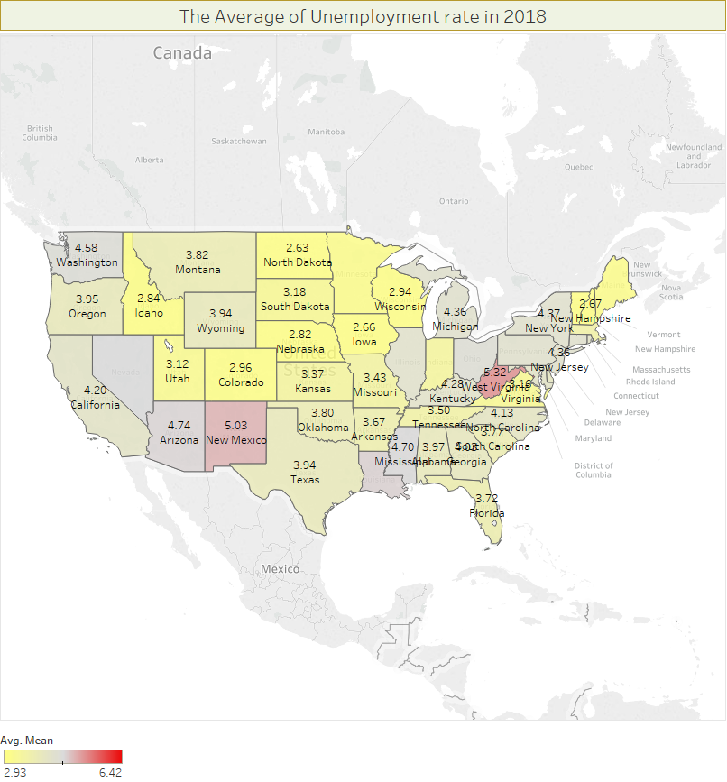
Unemployment Rate in 2001 and 2018

Slide 5
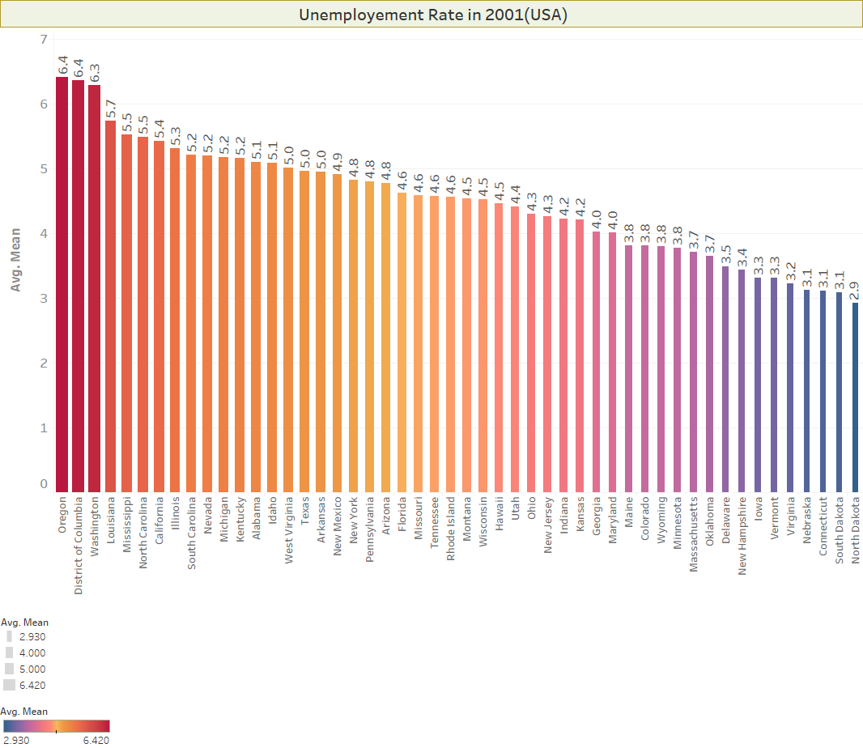
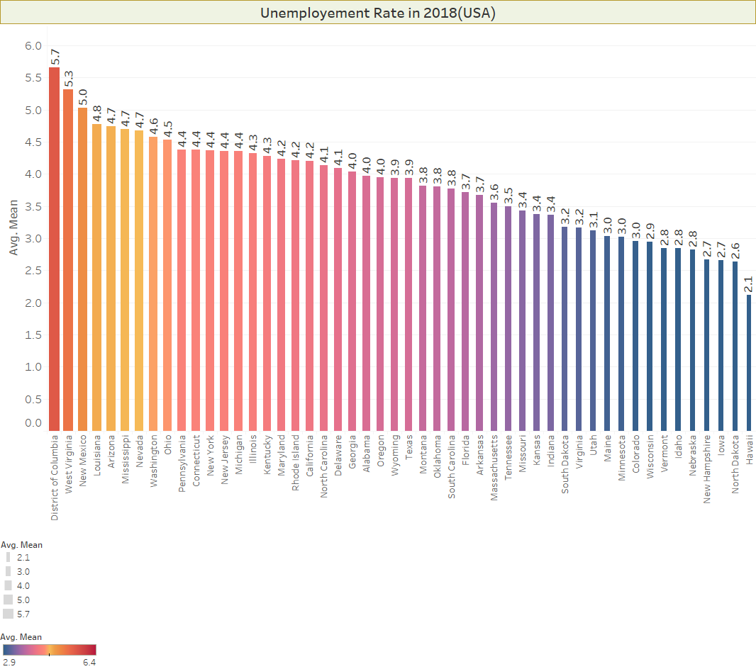

Slide 6
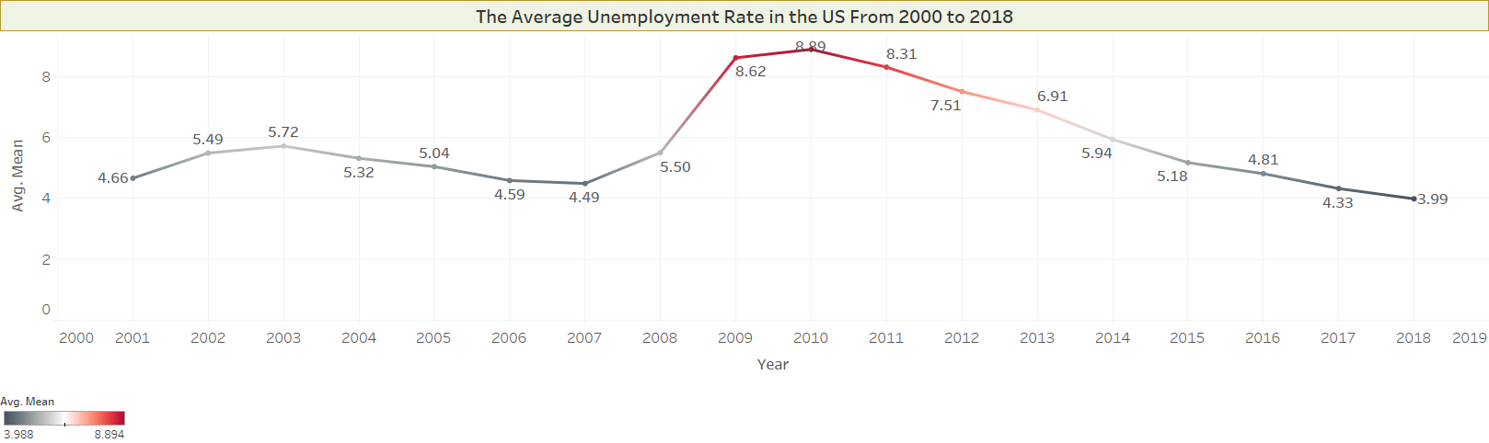
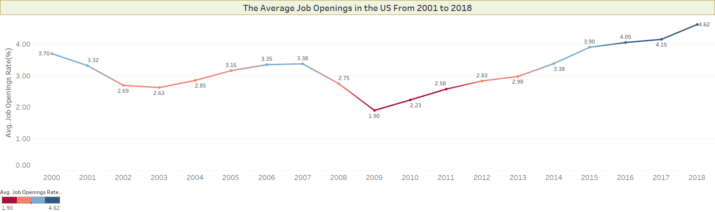

Slide 8
Conclusion
In most states Unemployment rate has substantially declined
Midwest region has the lowest rate in 2001 and 2018
Oregon, District of Columbia, and Washington had the highest unemployment rates in 2001
District of Columbia, West Virginia, and New Mexico have the highest unemployment rates in 2018
From 2001 to 2018, The overall unemployment rate dropped from form 4.66% to 3.99%. On the other hand, job openings rate has significantly increased from 3.7 to 4.62%
Layoff rate has also dropped from 1.6 in 2001 to 1.23 in 2018

Slide 9
Data Sources
Unemployment data:
https://www.bls.gov/lau/
Layoff rate:
https://fred.stlouisfed.org/categories/32248
Job offers rate:
https://fred.stlouisfed.org/categories/32243

